Slide 1
AKS - Cluster

Slide 2
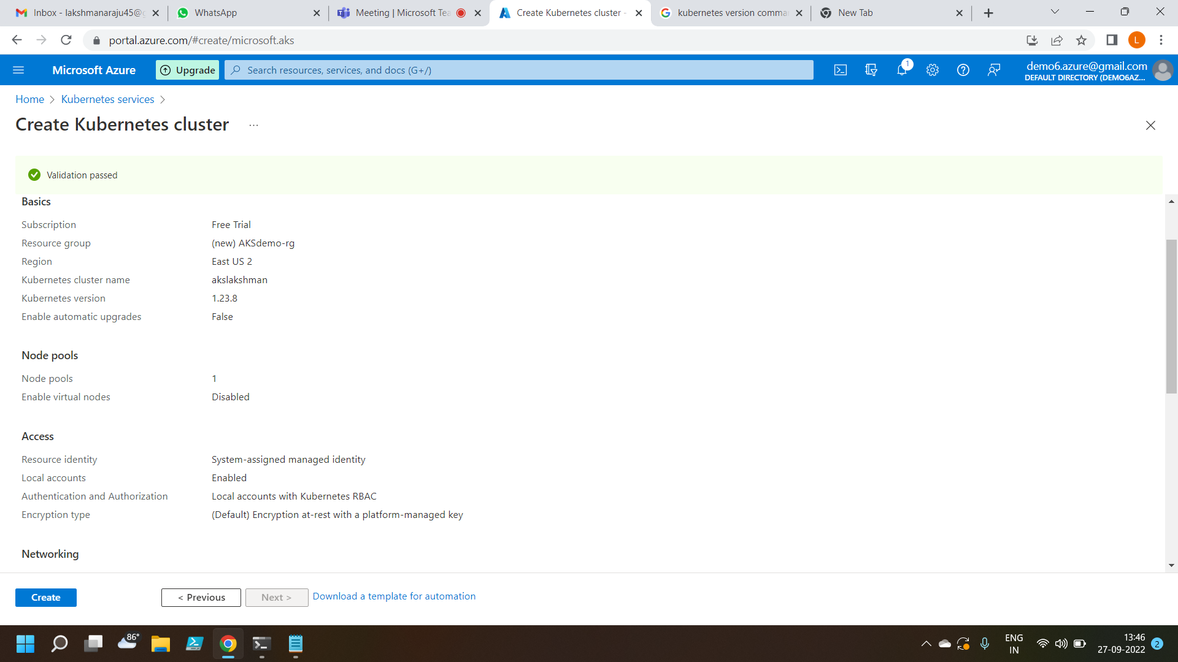
Creating AKS - Cluster

Slide 3
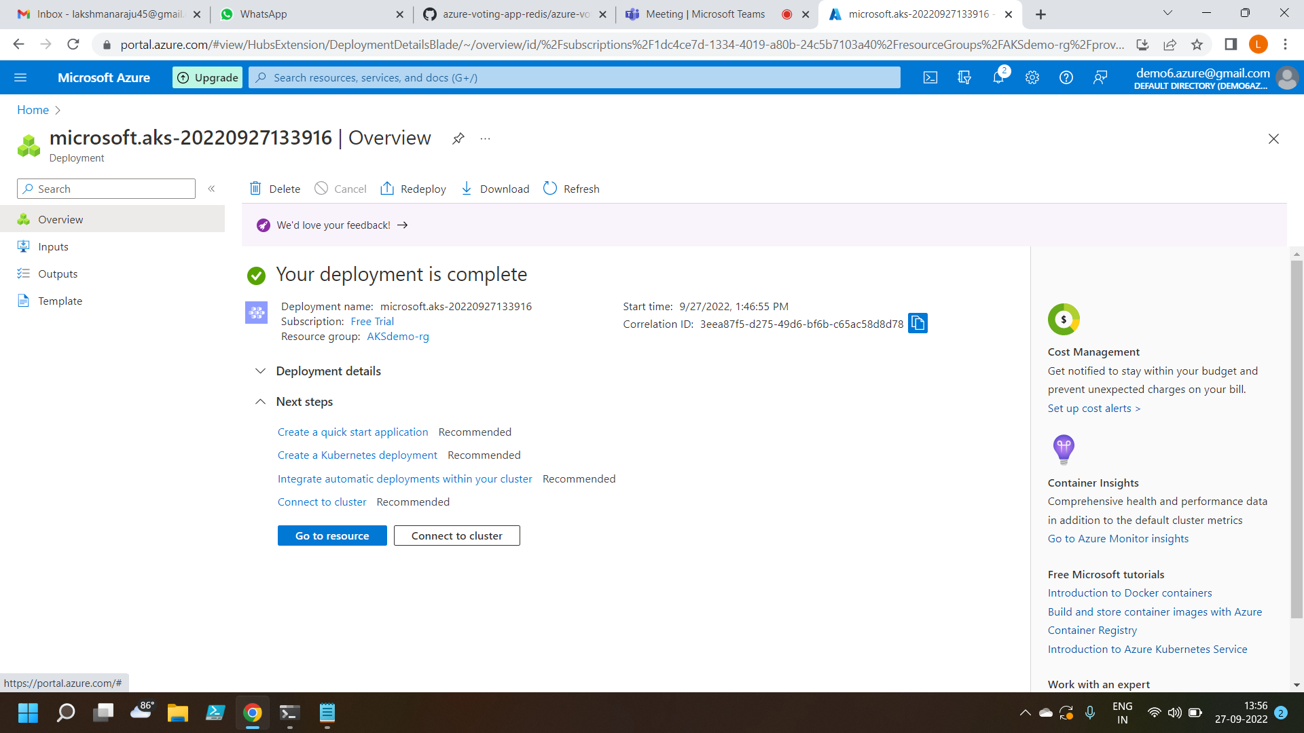
AKS – Cluster created

Slide 4
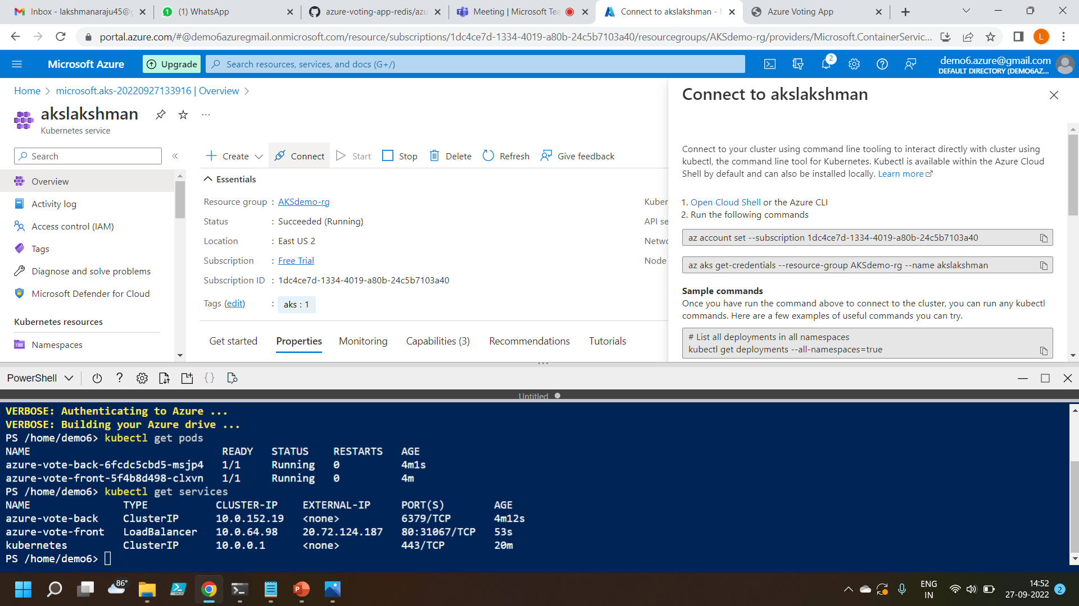
Connected AKS – Cluster powershell terminal

Slide 5
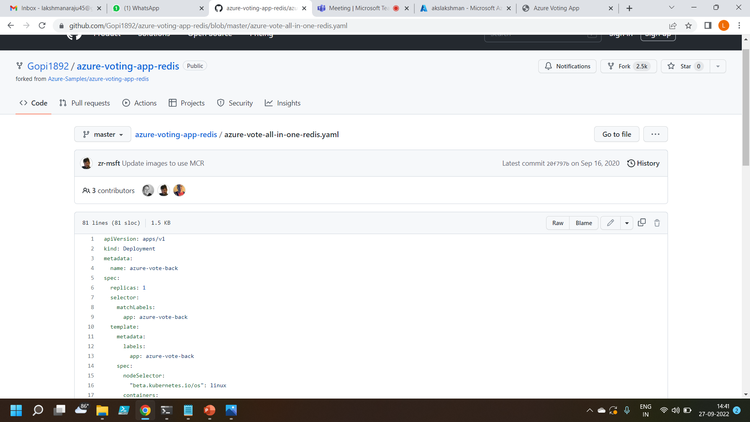
Copy the yaml file from Git hub

Slide 6
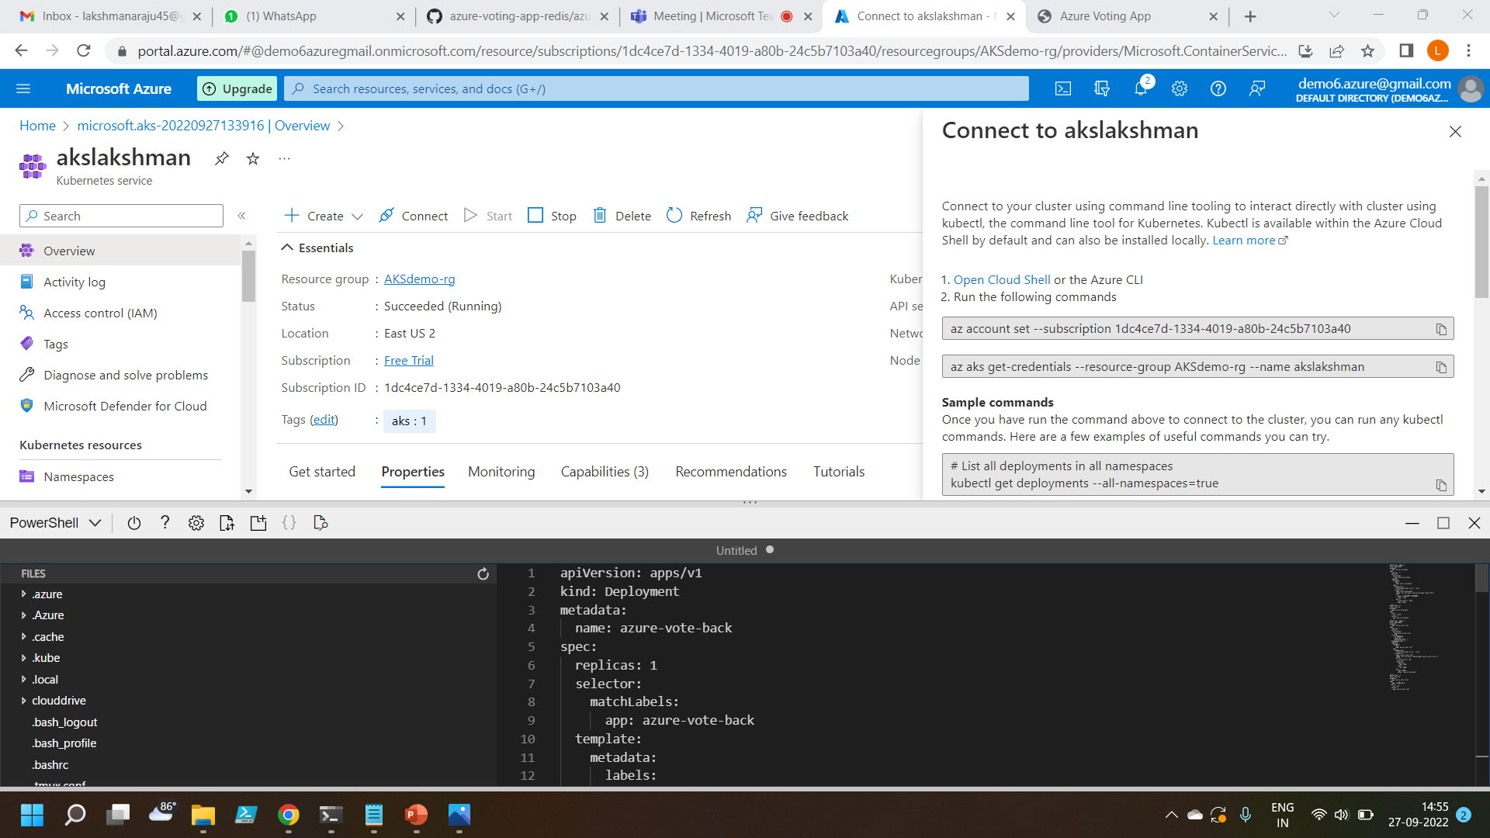
Paste the file in the editor and save it

Slide 7
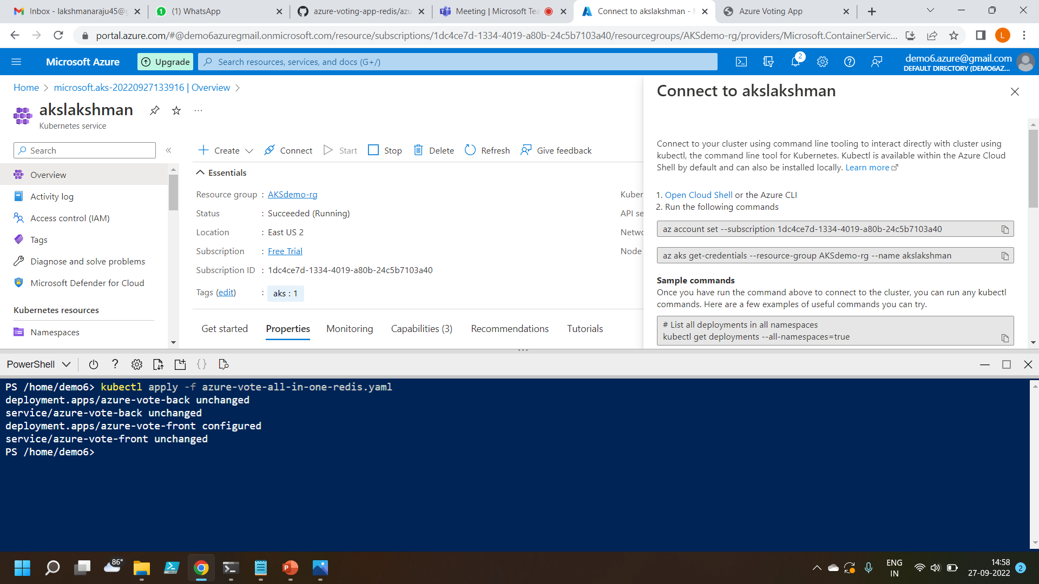
Run command to run the yaml file

Slide 8
Run commands to check pods and services

Slide 9
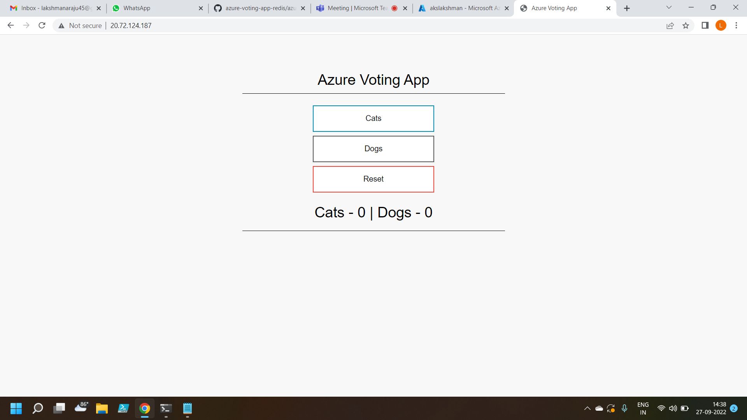
Copy the external IP and paste it in the browser to get the output

Slide 10
Thank you

